Slide 1
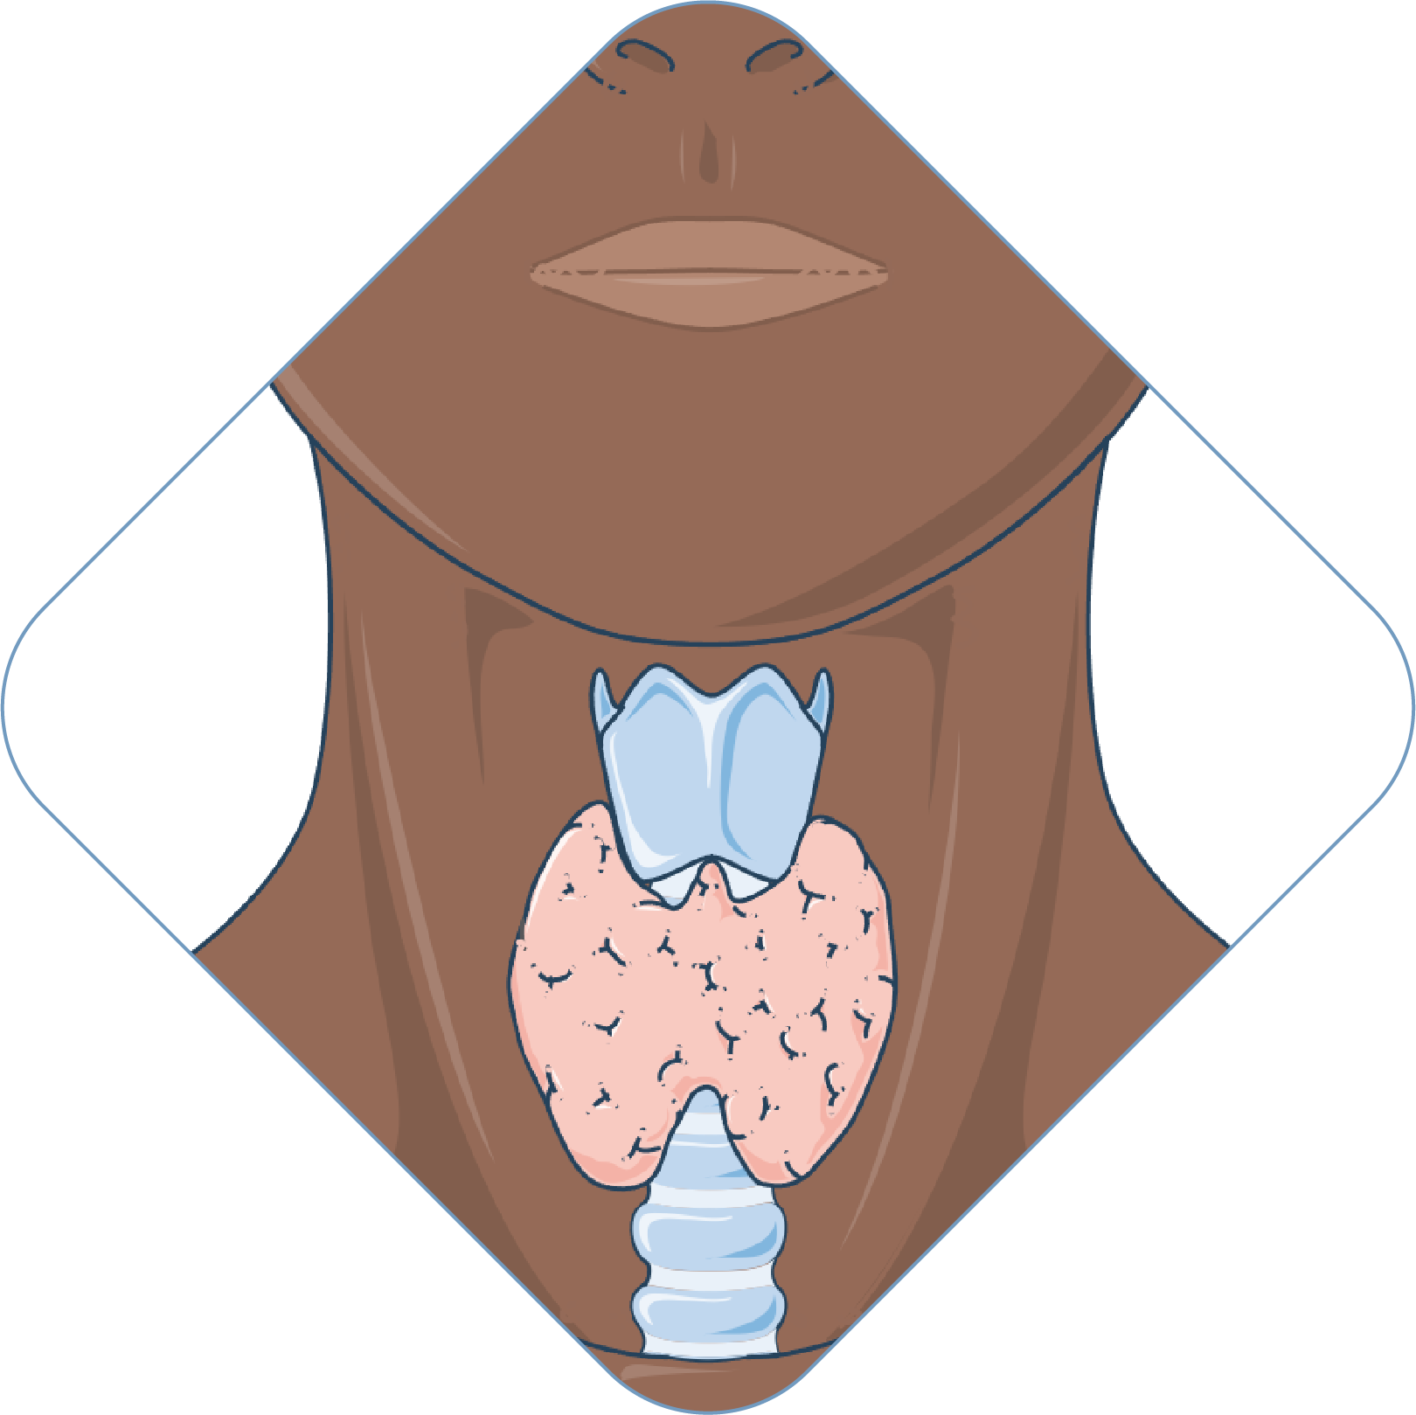
Enhancing Thyroid Disease Diagnosis with Machine Learning and Counterfactual Explainable AI
PRESENTED BY
J.VINAY
ROLL NO: 4511-23-733-070

Slide 2
Contents
ABSTRACT
INTRODUCTION
LITERATURE SURVEY
EXISTING SYSTEM
DISADVANTAGES
PROPOSED SYSTEM
ADVANTAGES
SYSTEM REQUIREMENTS
SYSTEM ARCHITECTURE
MODULES
UML DIAGRAMS
FUTURE SCOPE
CONCLUSION
REFERENCES

Slide 3
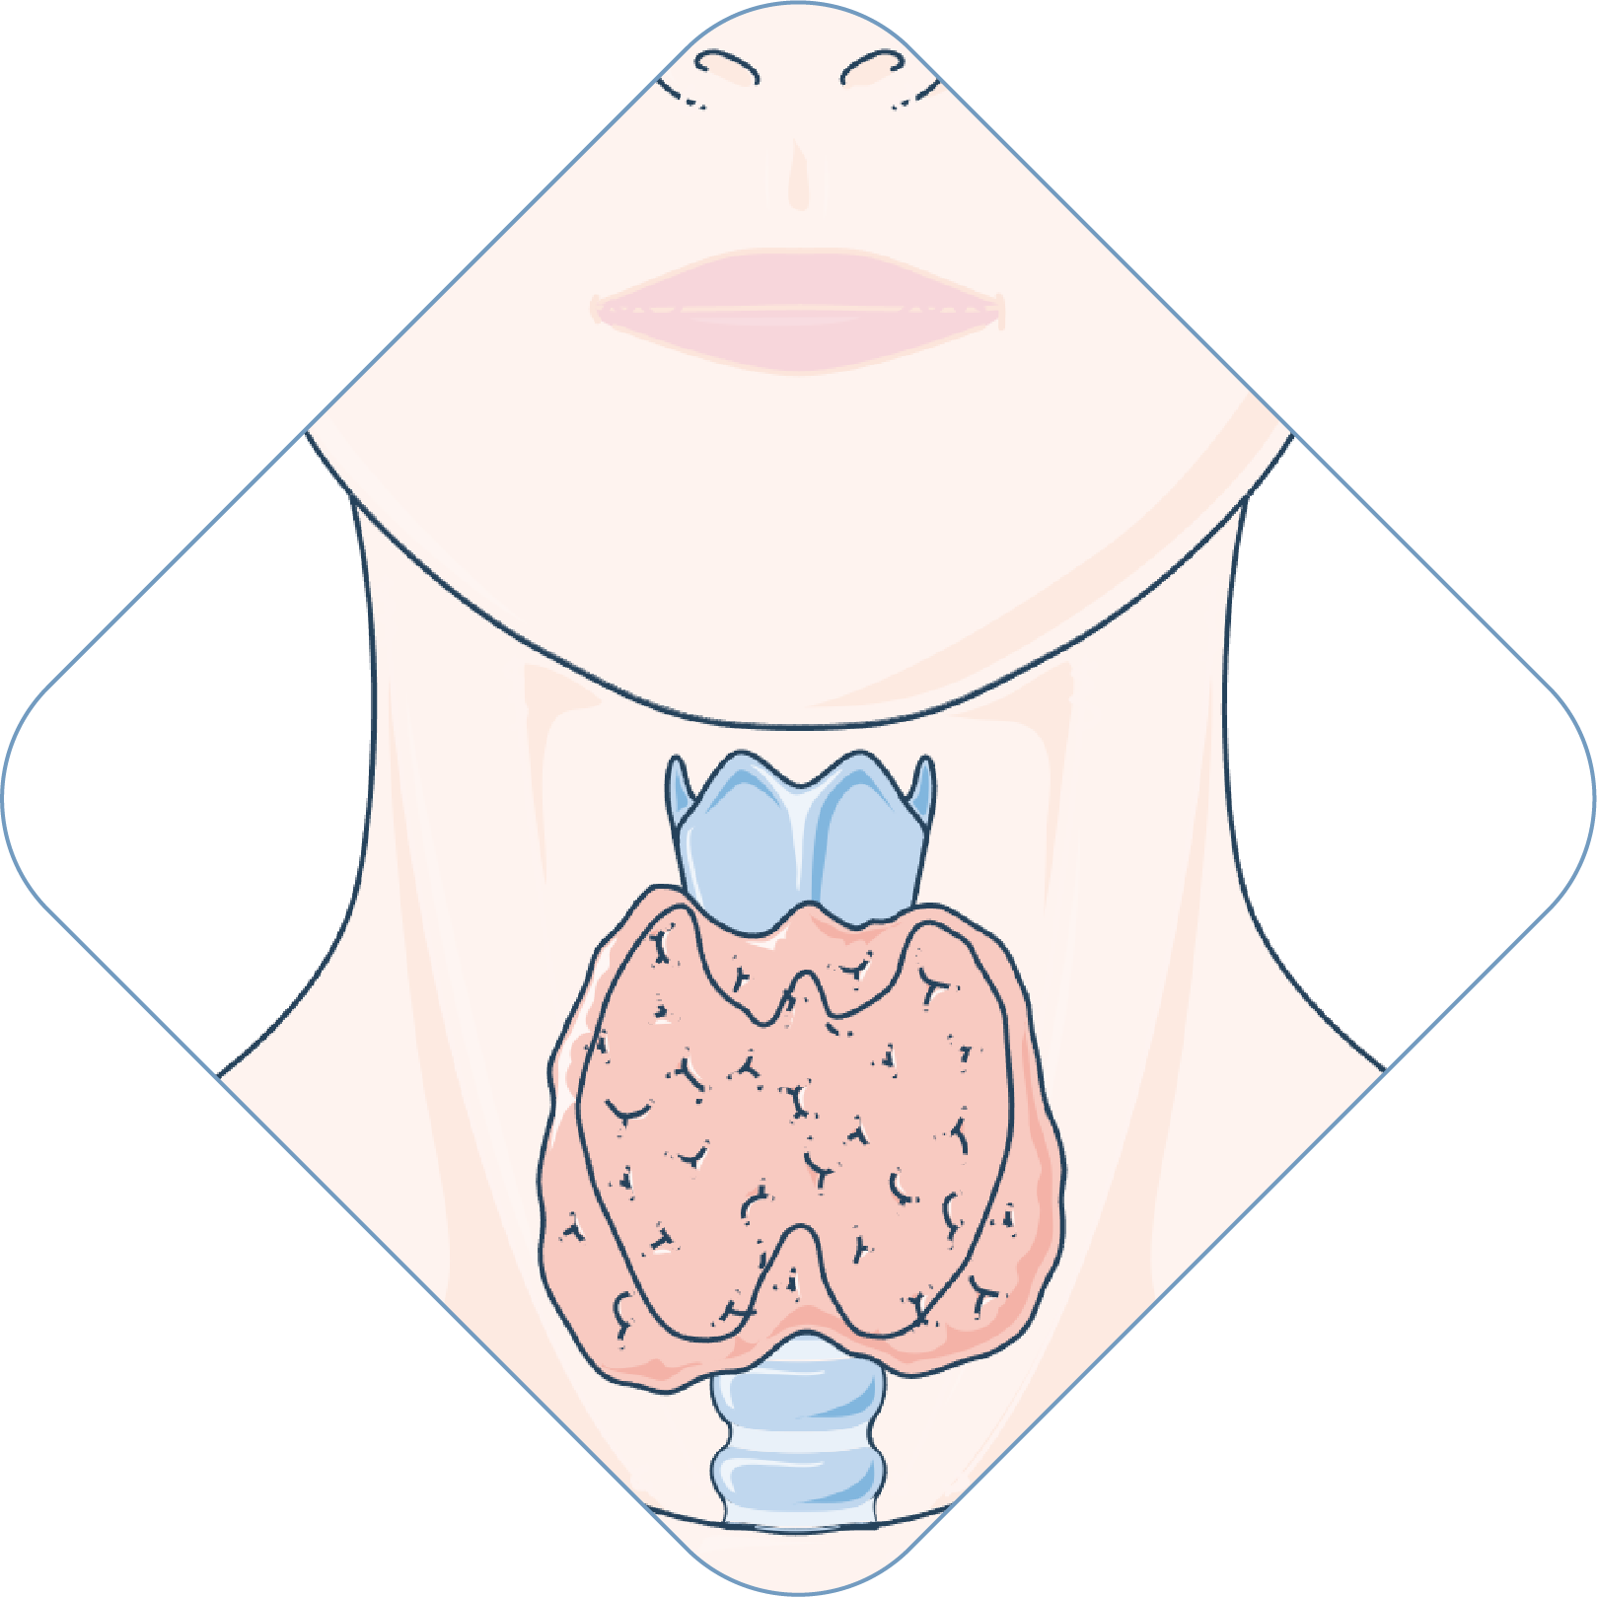
ABSTRACT

Slide 4
Thyroid disease affects many people and is often difficult to detect because its symptoms are similar to other health problems. In this project, we developed a machine learning system to predict thyroid disease using a dataset from the UCI repository. We tested different algorithms such as Random Forest, CatBoost, and Support Vector Classifier to find the best model. The system achieved very high accuracy of up to 99.7% using only ten important medical features. To make the predictions easier to understand, we used Explainable AI techniques like SHAP and counterfactual analysis, which help explain how features such as TSH and FTI influence the results., it provides both accurate predictions and clear explanations, making it useful for healthcare applications.

Slide 5
INTRODUCTION

Slide 6
Thyroid disease is a common disorder that affects hormone production and body metabolism.
Early detection of thyroid disease is important to avoid serious health complications.
Machine Learning techniques help in predicting thyroid disease using medical data.
Explainable AI improves trust by making prediction results understandable for doctors.
The proposed system provides accurate and faster thyroid disease prediction.

Slide 7
LITERATURE SURVEY – 1

Slide 8
“Thyroid disease prediction using selective features and machine learning techniques,” Cancers, R. Chaganti, F. Rustam, I. De La Torre Díez, et al., vol. 14, no. 16, p. 3914, 2022.
Focus: Thyroid disease prediction using feature selection methods.
Results: Achieved high accuracy with selected important features.
Drawback: Limited external validation and class imbalance issues.
Conclusion: Feature selection improves efficiency and model accuracy.

Slide 9
LITERATURE SURVEY – 2

Slide 10
“Machine learning approaches for thyroid disease diagnosis,” Computers in Biology and Medicine, M. Islam, R. Ferdousi, and S. Rahman, vol. 125, p. 103990, 2020.
Focus: Thyroid disease diagnosis using machine learning approaches.
Results: Improved prediction accuracy for thyroid disease detection.
Drawback: Required large datasets and higher computational cost.
Conclusion: ML methods are effective in healthcare diagnosis systems.

Slide 11
LITERATURE SURVEY – 3

Slide 12
“Comparative analysis of machine learning classifiers for thyroid disease detection,” Procedia Computer Science, S. Duggal and R. Shukla, vol. 152, pp. 60–67, 2019.
Focus: Comparison of machine learning classifiers for thyroid detection.
Results: Some ML models achieved better accuracy than others.
Drawback: Models were difficult to interpret and explain.
Conclusion: Comparative analysis helps select the best prediction model.

Slide 13
EXISTING SYSTEM

Slide 14
Traditional diagnosis depends mainly on laboratory tests and medical experts.
Existing systems may take more time and can be less accurate.
Many prediction systems work like black boxes and are difficult to interpret.
Large datasets and complex processing are often required

Slide 15
DISADVANTAGES
Lower prediction accuracy in traditional systems.
Difficult to understand prediction results.
Requires more clinical data and processing time.
Less suitable for real-time healthcare support.

Slide 16
PROPOSED SYSTEM

Slide 17
The proposed system uses machine learning models for thyroid disease prediction.
Important features like TSH, T3, TT4, T4U, and FTI are used for classification.
Explainable AI techniques provide understandable predictions.
The system achieves high accuracy with fewer important features.
Suitable for healthcare decision support systems.

Slide 18
ADVANTAGES
High prediction accuracy.
Faster disease detection.
Easy to understand predictions using XAI.
Requires fewer important medical features.
Helpful for doctors and healthcare systems.

Slide 19
SYSTEM REQUIREMENTS

Slide 20
Hardware Requirements:
Processor : Intel Core i3 (min)
RAM : 8 GB (min)
Hard Disk : 128 GB (min)
Software Requirements:
Operating System : Windows 7 (min)
IDE : Anaconda Jupyter Notebook
Coding Language : Python

Slide 21
SYSTEM ARCHITECHTURE

Slide 22
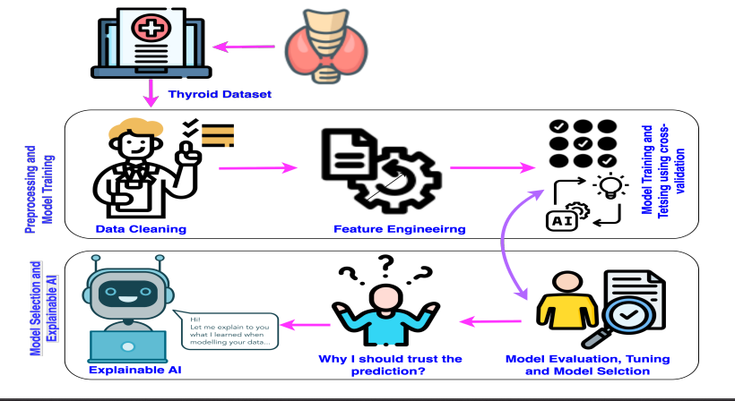

Slide 23
MODULES

Slide 24
Data Collection
Data Preprocessing
Model Building
Model Explainable AI (SHAP Analysis)
Model Evaluation
Performance Evaluation

Slide 25
DATA COLLECTION
Collected the Thyroid Disease Dataset (df) for prediction.
Dataset contains thyroid-related medical and laboratory data.
Important features include TSH, T3, TT4, T4U, and FTI.
Used the dataset to classify thyroid disease conditions.
https://www.kaggle.com/datasets/emmanuelfwerr/thyroid-disease-data?utm_source=chatgpt.com

Slide 26
DATA PREPROCESSING
Removed missing and duplicate values.
Converted categorical data into numerical form.
Normalized important medical features.
Prepared clean data for model training.

Slide 27
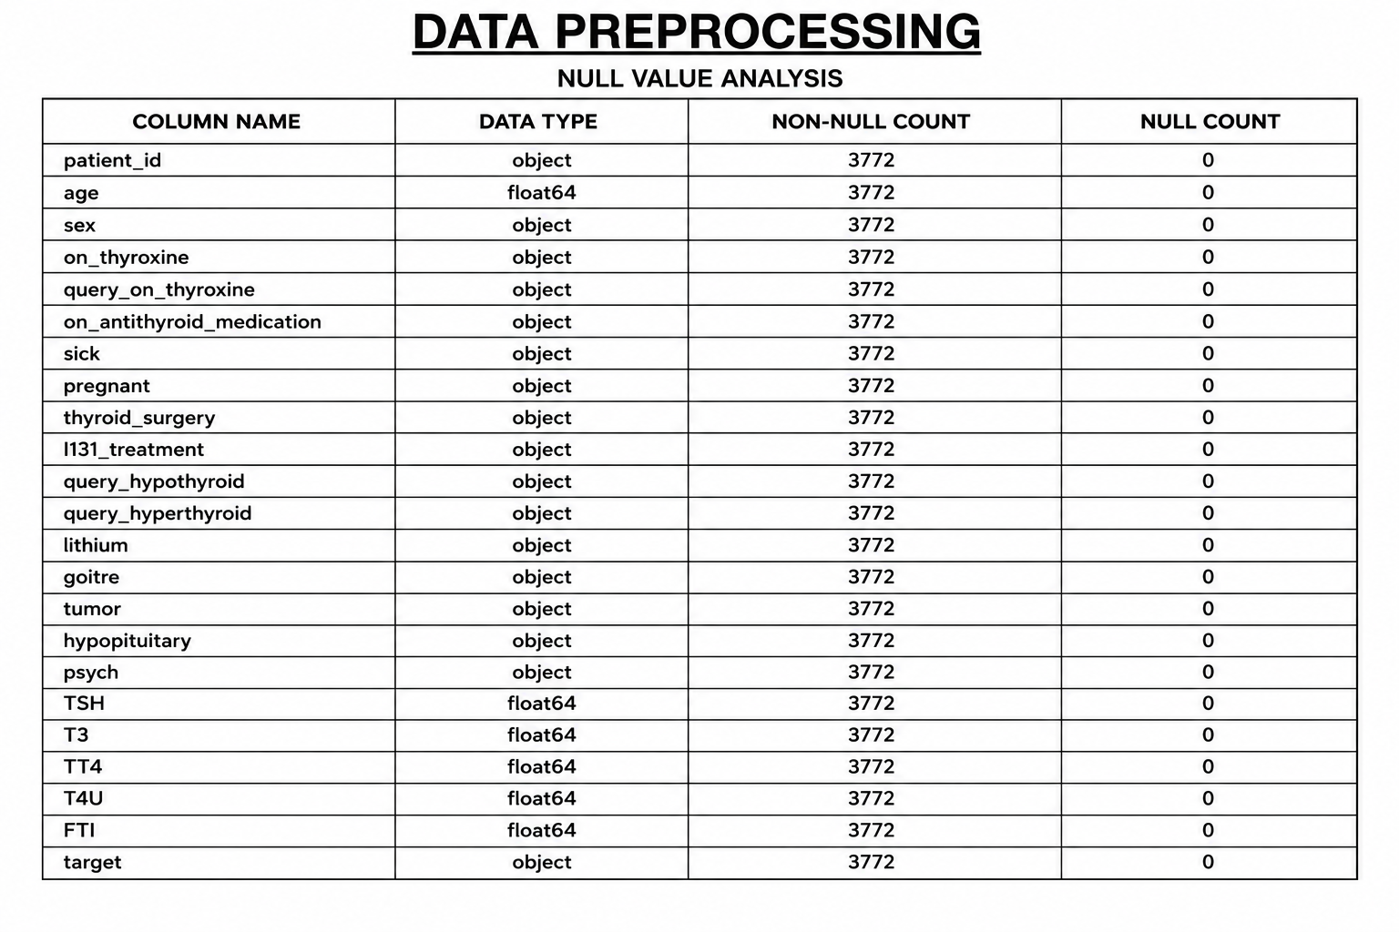

Slide 28
MODEL BUILDING
Split the dataset into training and testing sets.
Trained different machine learning algorithms.
Compared models using accuracy and AUC score.
Selected the best-performing prediction model.

Slide 29
RANDOM FOREST
Uses multiple decision trees for prediction.
Handles complex medical data effectively.
Reduces overfitting and improves accuracy.
Performs well for thyroid disease classification.

Slide 30
SVC
Used for thyroid disease classification tasks.
Creates optimal boundaries between classes.
Works well with high-dimensional data.
Provides good prediction performance.

Slide 31
EXTRA TREES
Ensemble learning algorithm based on multiple random decision trees.
Handles large and complex medical datasets efficiently.
Reduces variance and improves prediction stability.
Provides good accuracy for thyroid disease classification

Slide 32
ADABOOST
Combines multiple weak classifiers.
Improves prediction step by step.
Reduces classification errors effectively.
Enhances overall model accuracy.

Slide 33
CATBOOST
Gradient boosting algorithm for prediction.
Handles categorical features efficiently.
Reduces overfitting problems.
Provides high accuracy on medical datasets.

Slide 34
MODEL EVALUATION
Accuracy score is used to measure prediction performance.
Precision, Recall, and F1-Score evaluate classification quality.
Confusion Matrix is used to analyze prediction results.
ROC Curve and AUC Score measure model effectiveness.

Slide 35
MODEL EXPLAINABILITY (SHAP)
SHAP (SHapley Additive Explanations) is used to explain model predictions.
It shows the importance of each feature in thyroid disease prediction.
Features like TSH and FTI highly influence the prediction results.
SHAP improves transparency and trust in machine learning models.

Slide 36
COUNTERFACTUAL EXPLAINABLE AI
Counterfactual AI explains how prediction results can change.
It generates alternative patient conditions for different outcomes.
Helps understand important medical feature changes.
Improves transparency and interpretability of machine learning models.

Slide 37
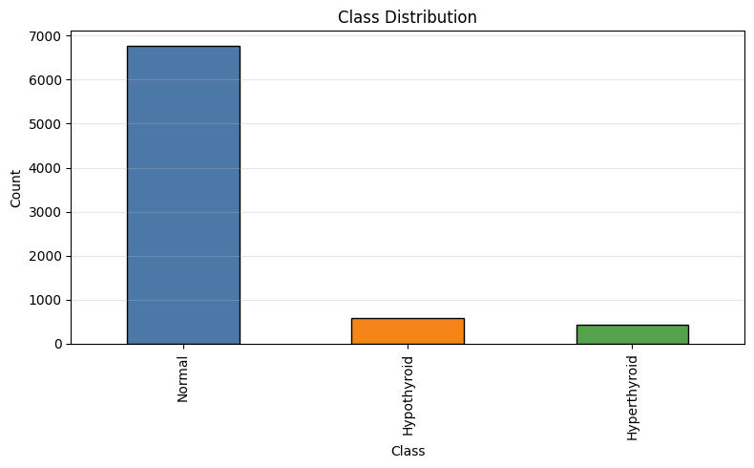
DATA VISUALIZATION

Slide 38
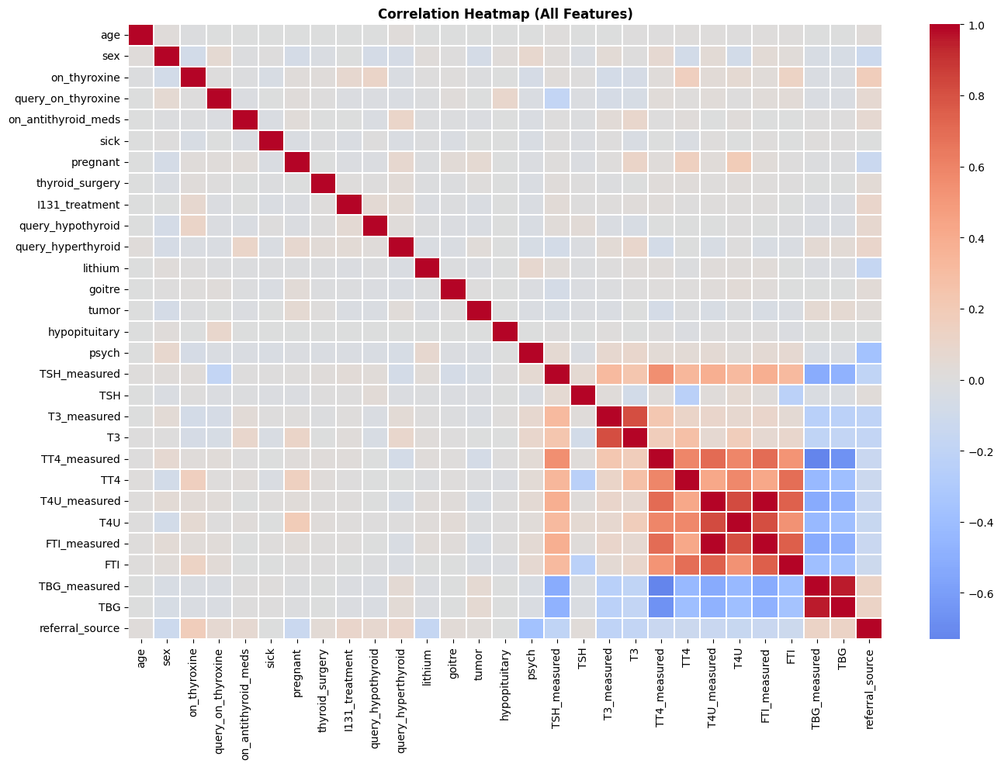

Slide 39
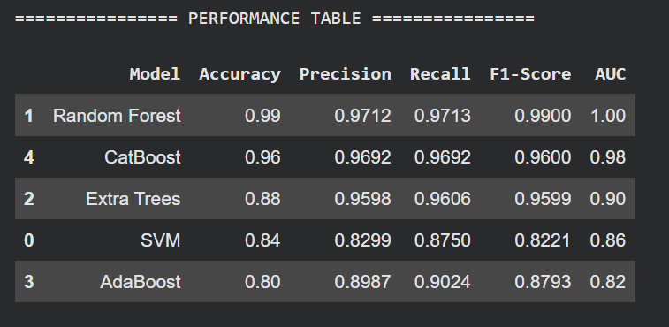

Slide 40
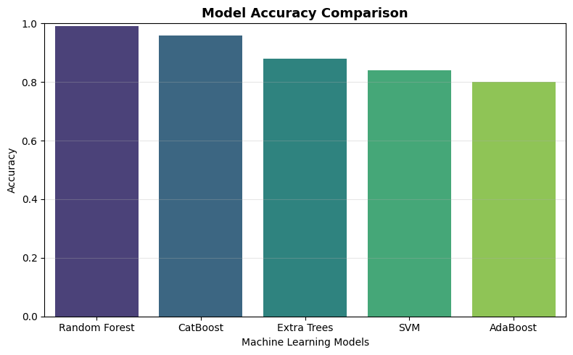

Slide 41
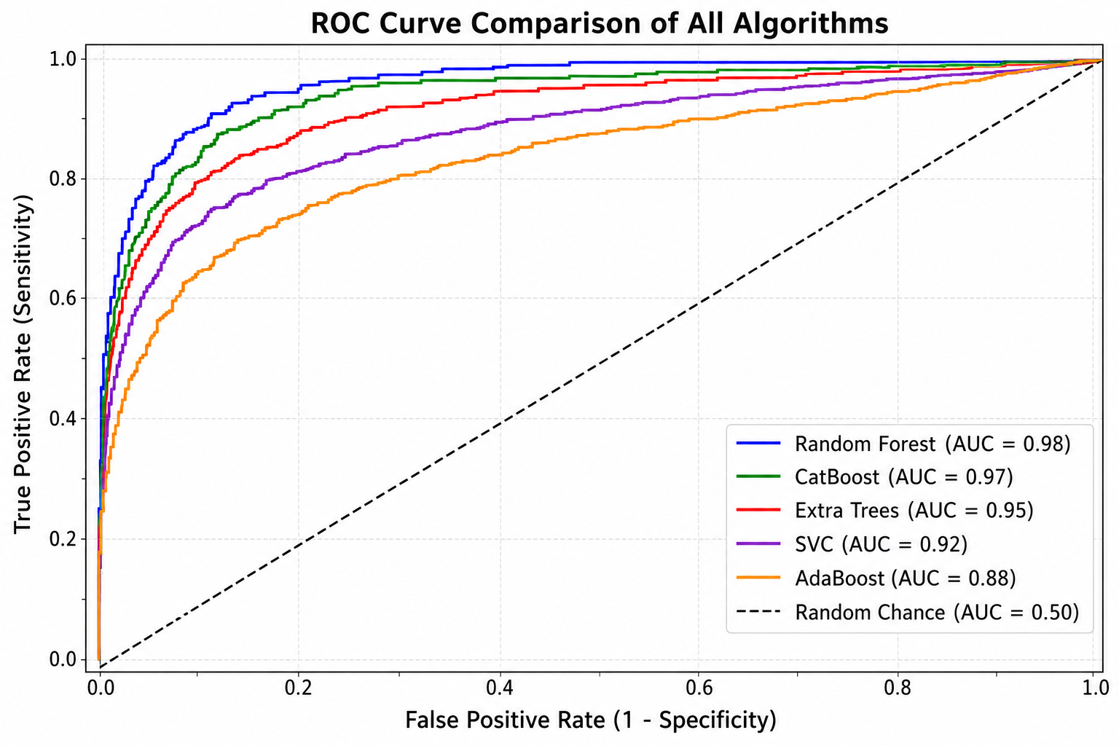

Slide 42
UML DIAGRAMS

Slide 43
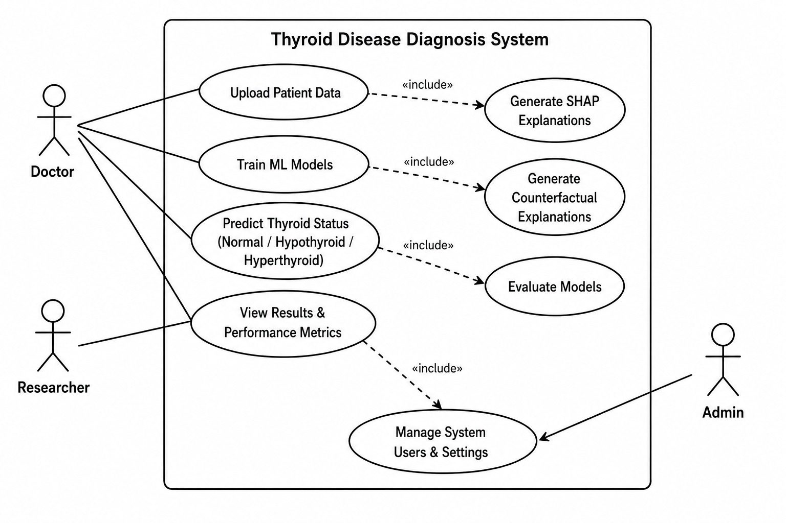
USE CASE DIAGRAM

Slide 44
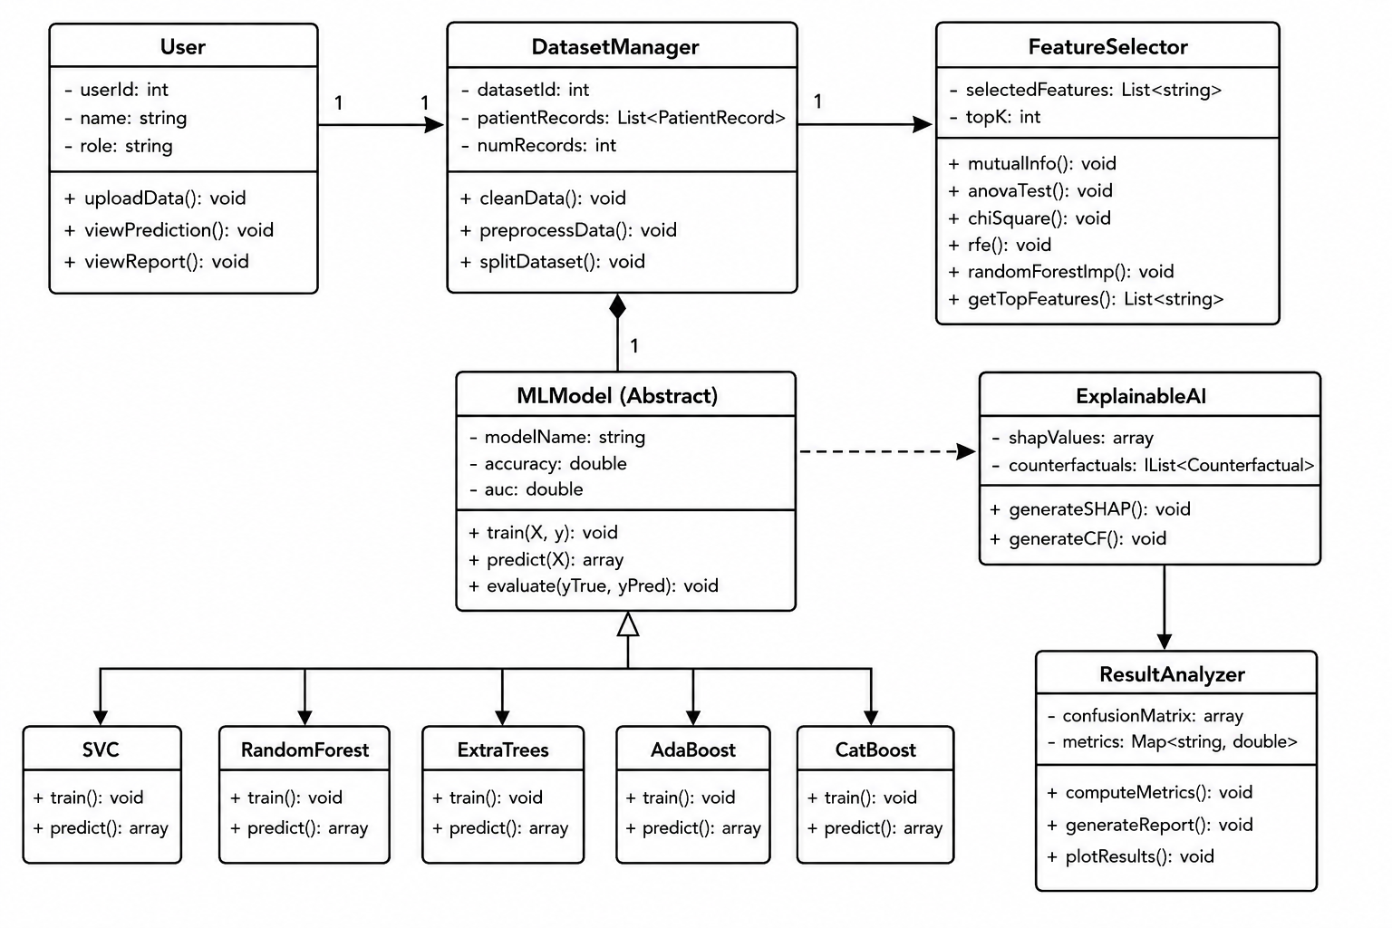
CLASS DIAGRAM

Slide 45
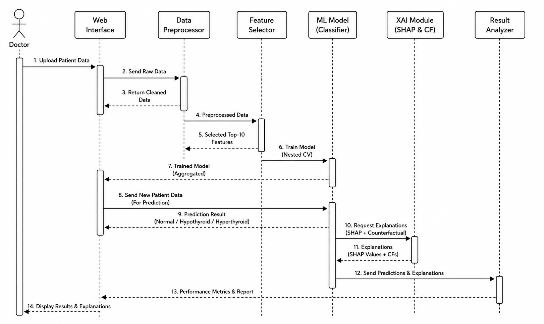
SEQUENCE DIAGRAM

Slide 46
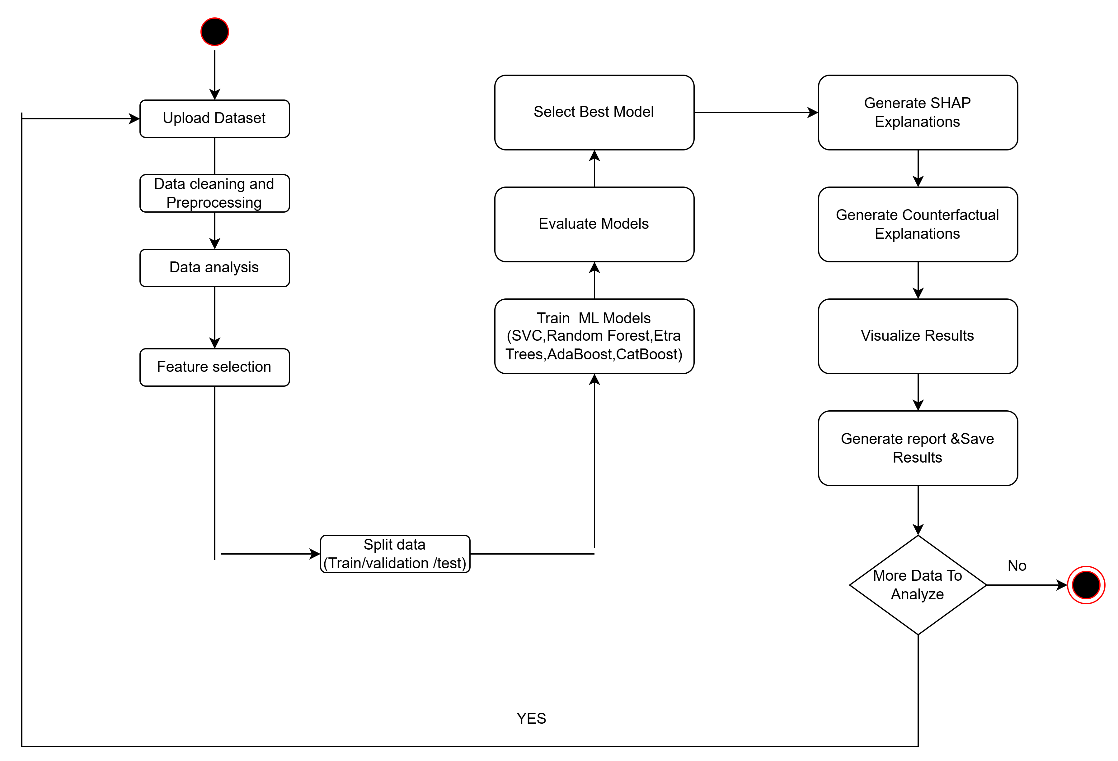
ACTIVITY DIAGRAM

Slide 47
FUTURE SCOPE

Slide 48
Implement deep learning models to achieve higher accuracy in thyroid disease prediction.
Develop web and mobile applications for real-time thyroid diagnosis and monitoring.
Use larger real-world healthcare datasets to improve model performance and reliability.
Enhance Explainable AI techniques to support doctors in clinical decision-making.

Slide 49
CONCLUSION

Slide 50
In This We successfully implemented machine learning techniques for thyroid disease prediction using the thyroid disease dataset. Different algorithms such as Random Forest, SVC, AdaBoost, Extra Trees, and CatBoost were applied and evaluated using multiple performance metrics. Random Forest achieved the highest prediction accuracy, while CatBoost also produced nearly similar and highly accurate results. Data preprocessing and feature selection improved the overall efficiency of the system. SHAP Explainable AI was used to identify the importance of medical features such as TSH and FTI in prediction. The proposed system provides accurate, reliable, and faster thyroid disease prediction, which can assist healthcare professionals in early diagnosis and effective clinical decision-making.

Slide 51
REFERENCES

Slide 52
R. Chaganti, F. Rustam, I. De La Torre Díez, et al., “Thyroid disease prediction using selective features and machine learning techniques,” Cancers, vol. 14, no. 16, p. 3914, 2022.
S. Duggal and R. Shukla, “Comparative analysis of machine learning classifiers for thyroid disease detection,” Procedia Computer Science, vol. 152, pp. 60–67, 2019.
K. Salman and E. Sonuç, “Thyroid disease classification using machine learning algorithms,” Journal of Physics: Conference Series, vol. 1963, no. 1, p. 012140, 2021.

Slide 53
S. Sankar, A. Potti, G.N. Chandrika, et al., “Thyroid disease prediction using XGBoost algorithms,” Journal of Mobile Multimedia, vol. 18, no. 3, pp. 1–8, 2022.
L. Aversano, M.L. Bernardi, M. Cimitile, et al., “Thyroid disease treatment prediction with machine learning approaches,” Procedia Computer Science, vol. 192, pp. 1031–1040, 2021.

Slide 54
THANKYOU

